Slide 1
The Labyrinth
Producer : Alieke
Plannings manager : Alieke
Lead Artist : René
Lead Deveveloper : Faf
Level design : Sunray
User Experience : Lara
Quality Assurence : Sven

Slide 2
Inleiding
Concept
Story
Flow chart
Planning
Uren regristratie
Assetlist
Planning
Trello
Organisatie
Naming convention and Repository
Functioneel concept
Controls
Enemies
Player abilities
GUI
Grafisch concept
Character
Enemies
Environment
GUI
Resource budget
Technisch concept
Camera
Enemies
Player abilities
GUI

Slide 3
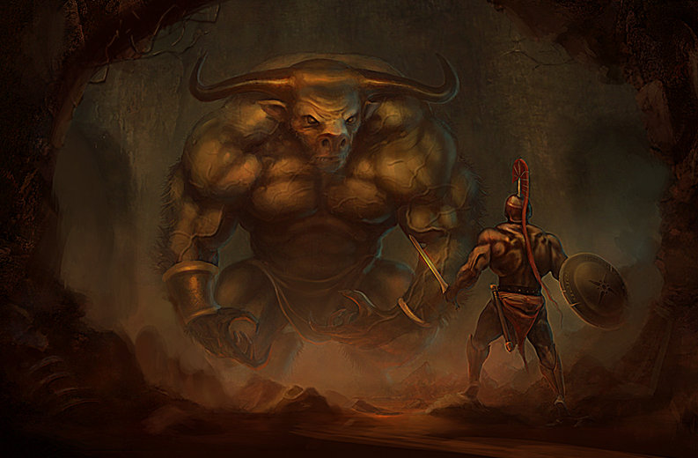
Concept - Story

Slide 4
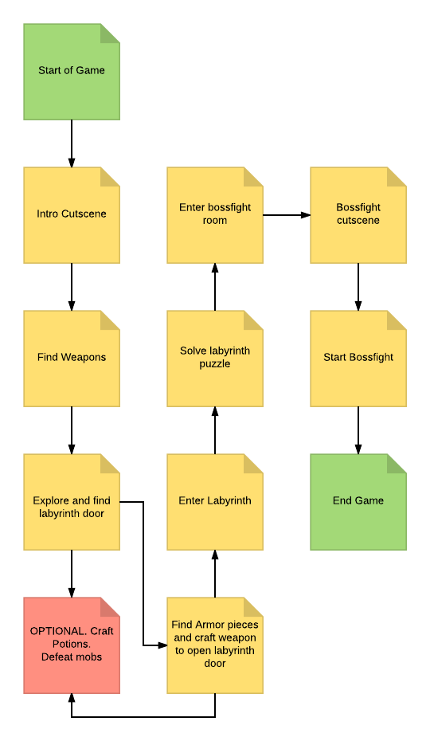
Concept – Game progression

Slide 5
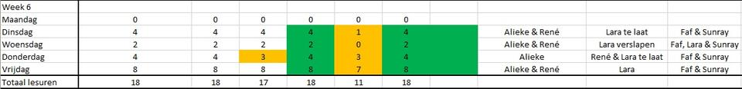
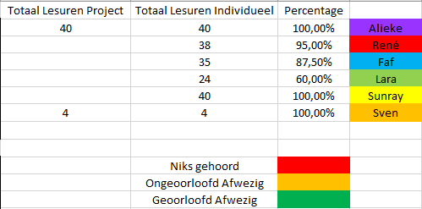
Planning – Uren registratie

Slide 6
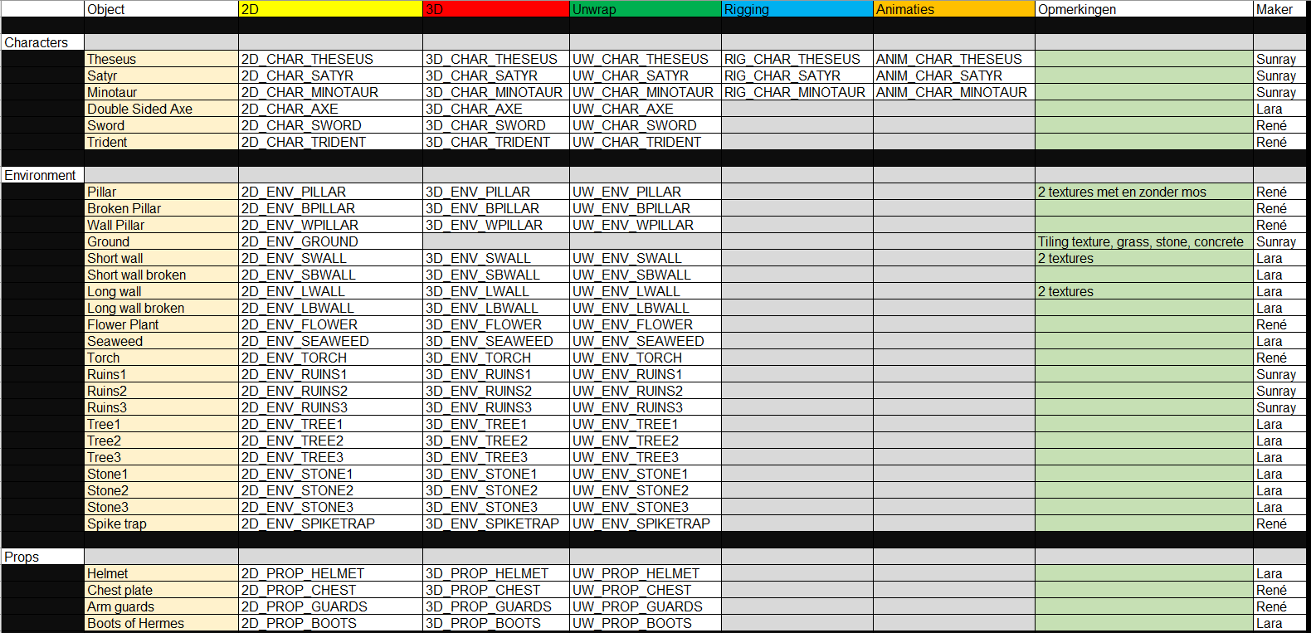
Planning - Assetlist

Slide 7
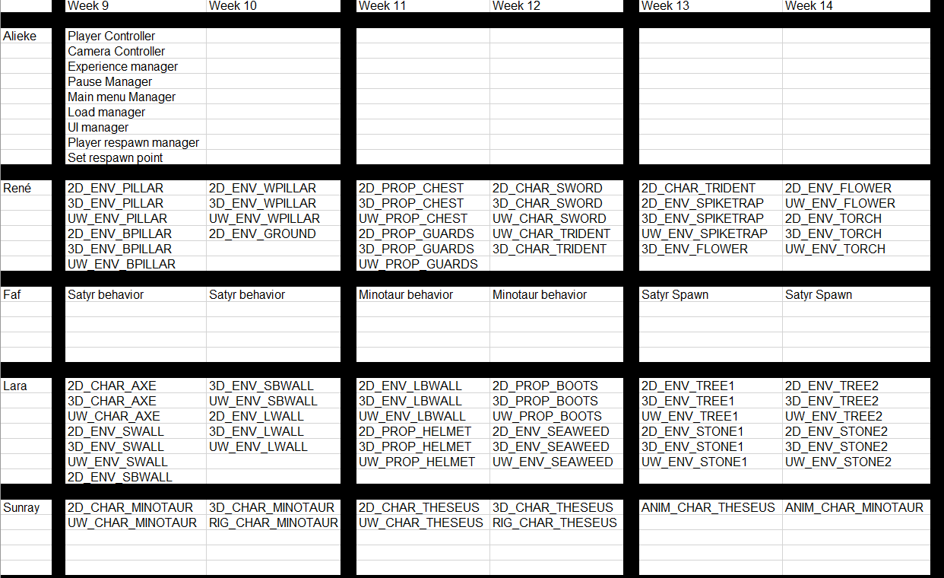
Planning - planning

Slide 8
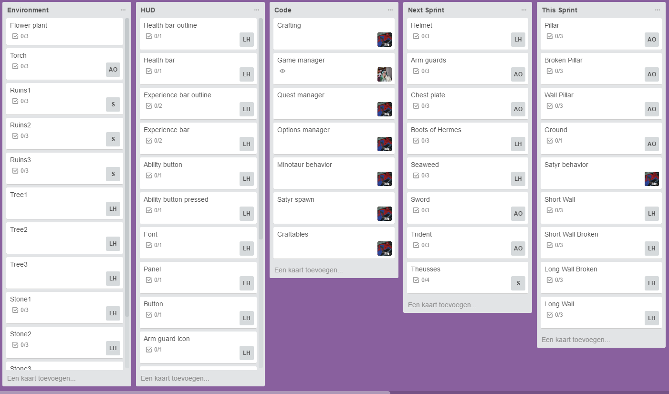
Planning – Trello

Slide 9

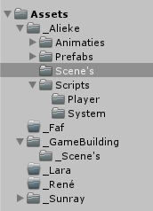
Organisatie – Naming Convention and Repository
Naamgeving
Mappen structuur
Git hub
Source tree
Git shell

Slide 10
Functioneel concept
Controls
Enemies
Player Abilities
GUI

Slide 11
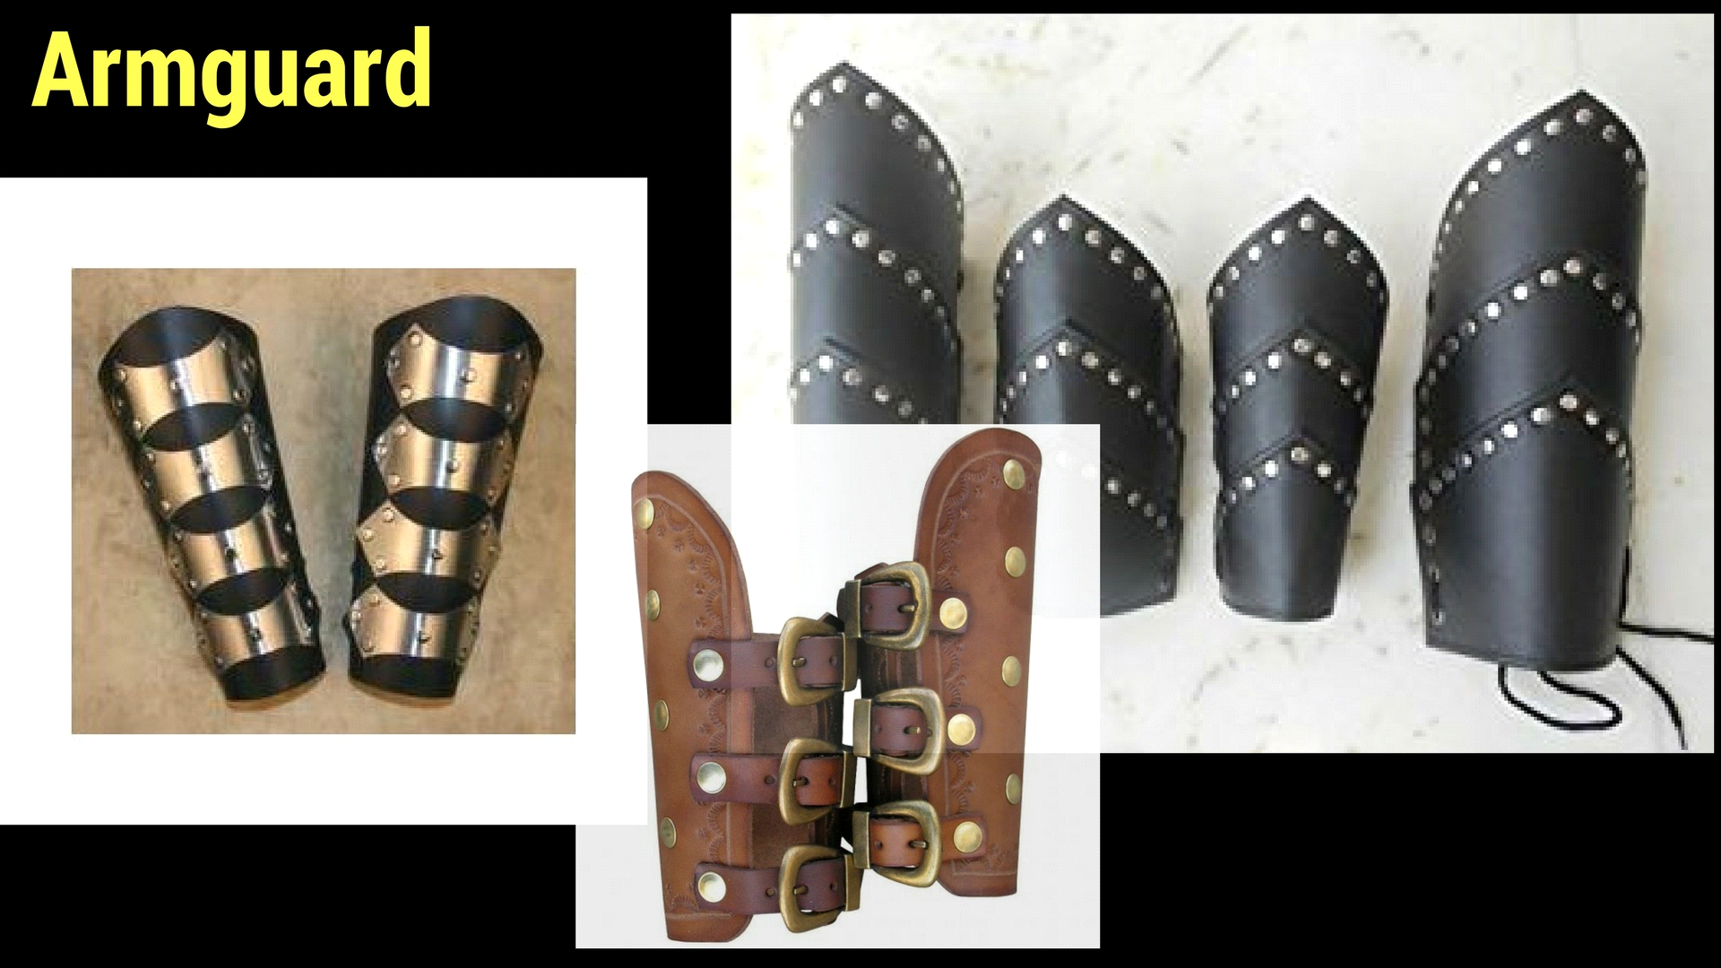
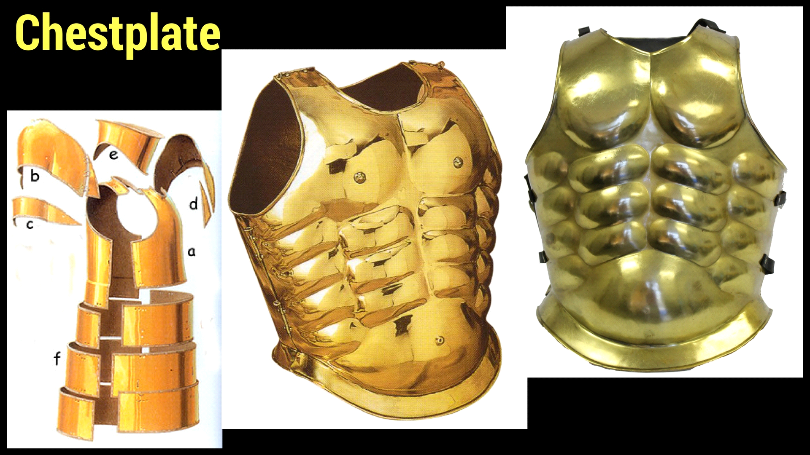
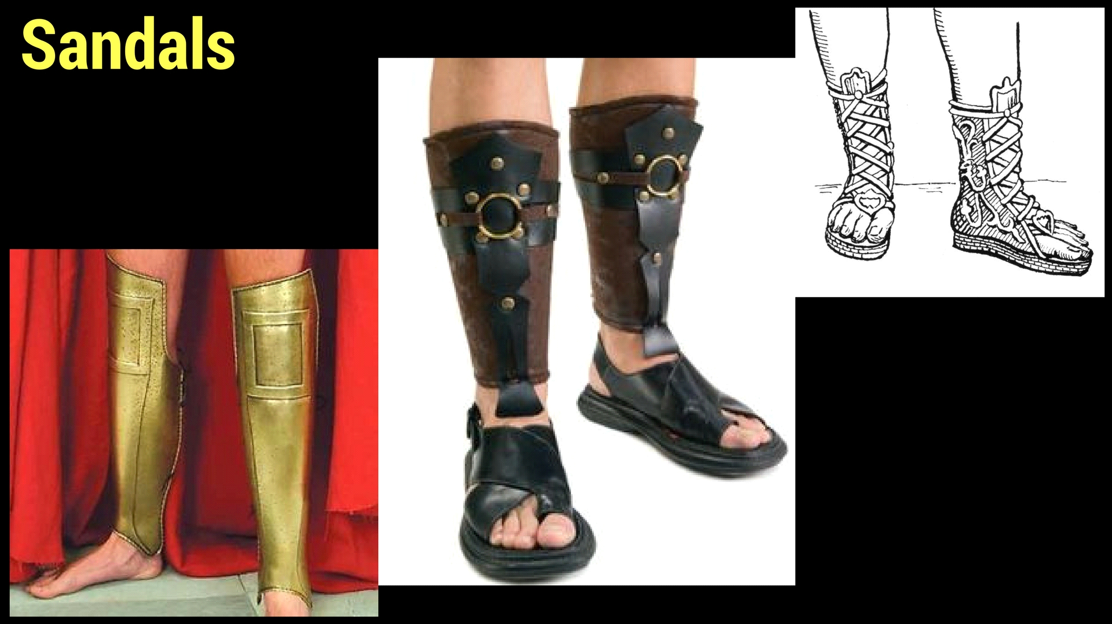
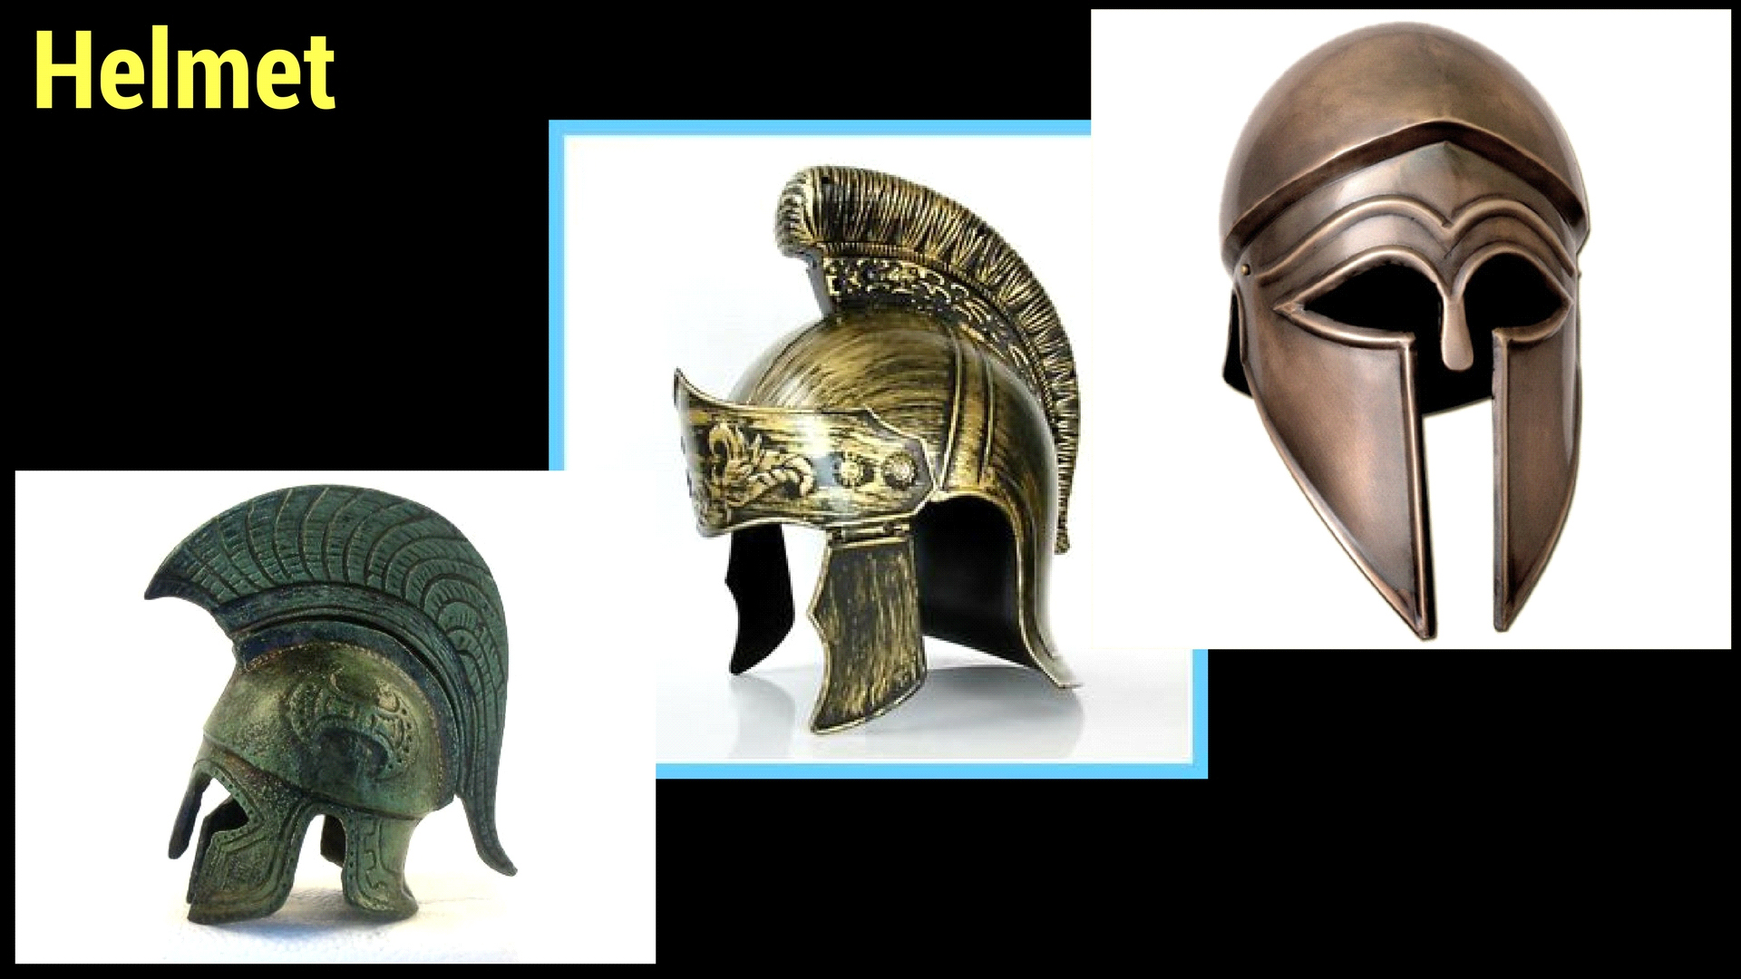
Grafisch concept - Character

Slide 12
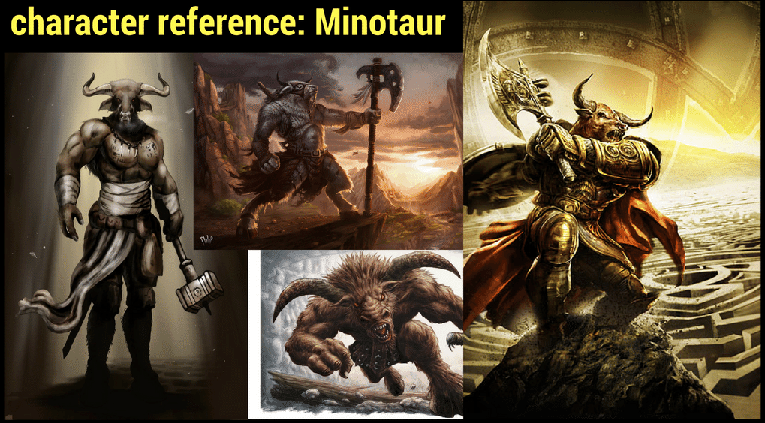
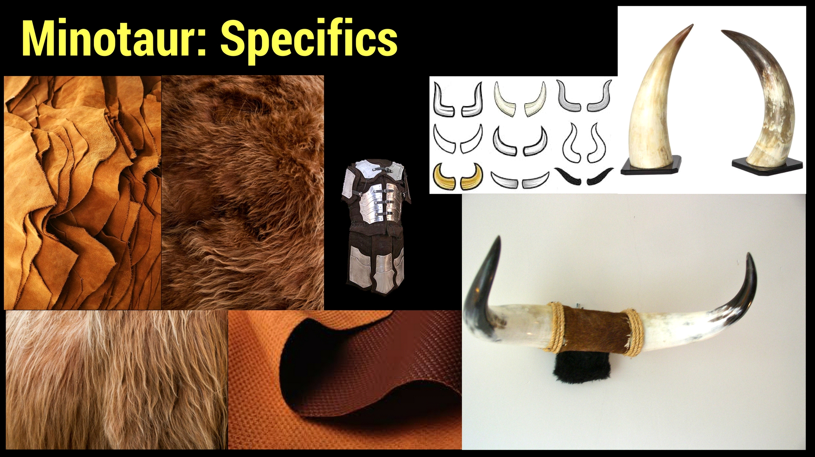
Grafisch concept - Enemies

Slide 13
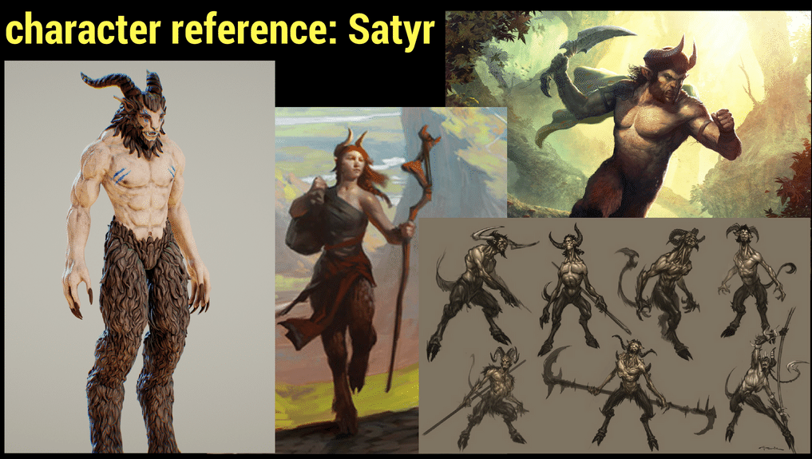
Grafisch concept - Enemies

Slide 14
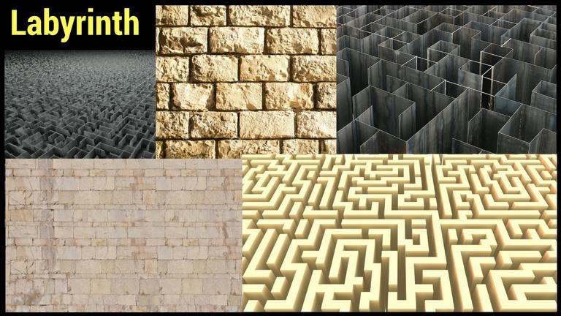
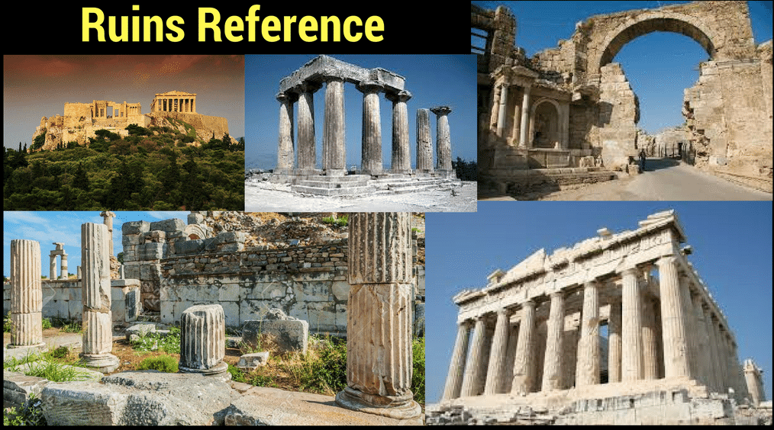
Grafisch concept - Environment

Slide 15
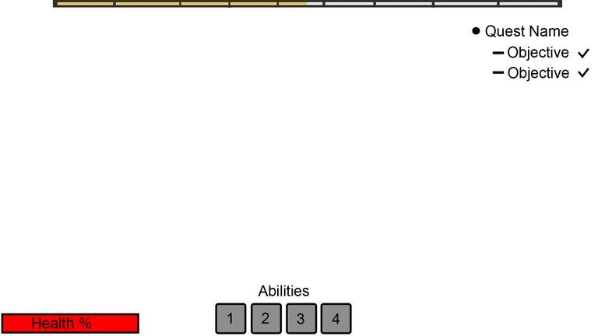
Grafisch concept - GUI

Slide 16
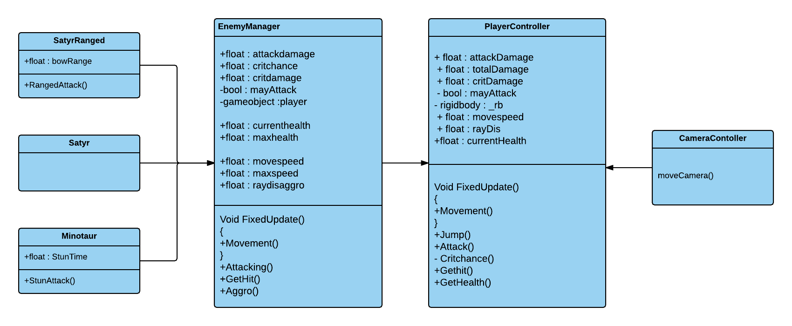
Technisch concept
Camera
Enemies
Player abilities

Slide 17

THE END

